Slide 1
CSC2211: Algorithms
Dynamic Programming

Slide 2
Algorithm design techniques
Iterative (brute-force) algorithms
Example: insertion sort
Algorithms that use efficient data structures
Example: heap sort
Divide-and-conquer algorithms
Example: Binary search, merge sort, quick sort
Dynamic programming
Example: Fibonacci numbers, Matrix multiplication optimization, Longest Common Subsequence
Greedy algorithms
Example: Huffman coding, Minimum Spanning Tree, Dijkstara
Graph Algorithms
Example: BFS (Robot moving, Path Finding), DFS( Topological Sorting, Strongly Connected Component)

Slide 3
Fibonacci Numbers
Leonardo Fibonacci (1202):
A rabbit starts producing offspring during the second year after its birth and produces one child each generation
How many rabbits will there be after n generations?
F(3)=1
F(1)=1
F(2)=1
F(3)=2
+1
F(4)=2
F(5)=3
+2
F(6)=5
+3
F(4)=3
+1
F(5)=5
F(6)=8

Slide 4
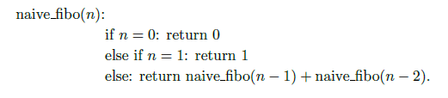
…Fibonacci Numbers
F(n)= F(n-1)+ F(n-2)
F(0) =0, F(1) =1
0, 1, 1, 2, 3, 5, 8, 13, 21, 34 …
Straightforward recursive procedure is slow!

Slide 5
…Fibonacci Numbers
F(6) = 8
F(5)
F(4)
F(4)
F(3)
F(3)
F(2)
F(3)
F(2)
F(2)
F(1)
F(2)
F(1)
F(1)
F(0)
F(2)
F(1)
F(1)
F(0)
F(1)
F(0)
F(1)
F(0)
F(1)
F(0)
We keep calculating the same value over and over!
Subproblems are overlapping – they share sub-subproblems

Slide 6
…Fibonacci Numbers
How many summations are there in F(n)?
F(n) = F(n – 1) + F(n – 2) + 1
F(n) ≥ 2F(n – 2) +1 and F(1) = F(0) = 0
Solving the recurrence we get
F(n) ≥ 2^{n/2} – 1 ≈ 1.4^{n}
Running time is exponential!

Slide 7
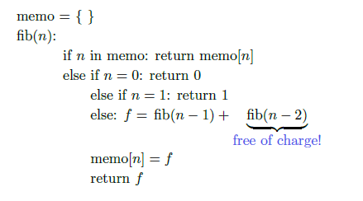
Fibonacci Numbers with Memoization

Slide 8
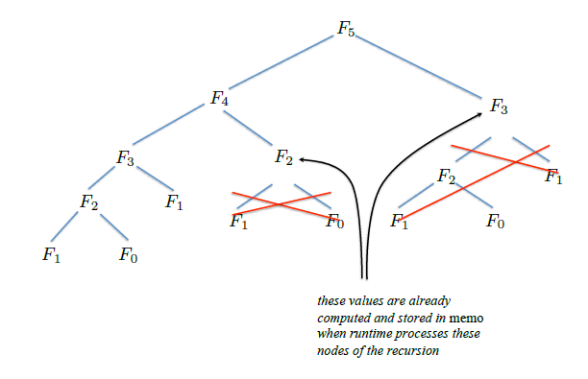
Fibonacci Numbers with Memoization

Slide 9
…Fibonacci Numbers
We can calculate F(n) in linear time by remembering solutions to the solved sub-problems (= dynamic programming).
Compute solution in a bottom-up fashion
Trade space for time!
Fibonacci(n)
01 F[0]←0
02 F[1]←1
03 for i ← 2 to n do
04 F[i] ← F[i-1] + F[i-2]
05 return F[n]

Slide 10
…Fibonacci Numbers
In fact, only two values need to be remembered at any time!
FibonacciImproved(n)
01 if n ≤ 1 then return n
02 Fim2 ←0
03 Fim1 ←1
04 for i ← 2 to n do
05 Fi ← Fim1 + Fim2
06 Fim2 ← Fim1
07 Fim1 ← Fi
05 return Fi

Slide 11
History
Dynamic programming
Invented in the 1957 by Richard Bellman as a general method for optimizing multistage decision processes
The term “programming” refers to a tabular method.
Often used for optimization problems.

Slide 12
Dynamic Programming
Solves problems by combining the solutions to sub-problems that contain common sub-sub-problems.
Difference between DP and Divide-and-Conquer
Using Divide and Conquer to solve these problems is inefficient as the same common sub-sub-problems have to be solved many times.
DP will solve each of them once and their answers are stored in a table for future reference.

Slide 13
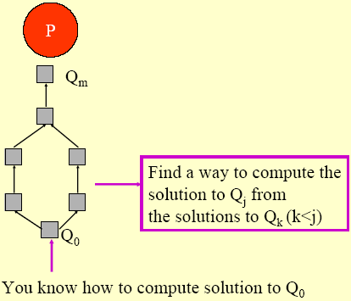
Intuitive Explanation
Given a problem P, obtain a sequence of problems Q₀, Q₁, …., Q_{m}, where:
You have a solution to Q₀
The solution to a problem Q_{j}, j > 0, can be obtained from solutions to problems Q₀...Q_{k}, k < j, that appear earlier in the “sequence”.

Slide 14
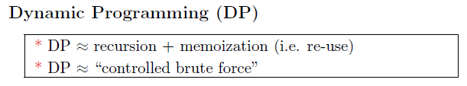

Elements of Dynamic Programming
DP is used to solve problems with the following characteristics:
Optimal sub-structure (Principle of Optimality)
an optimal solution to the problem contains within its optimal solutions to sub-problems.
Overlapping subproblems
there exist some places where we solve the same subproblem more than once

Slide 15
Example: Fibonacci Numbers
F(6) = 8
F(5)
F(4)
F(4)
F(3)
F(3)
F(2)
F(3)
F(2)
F(2)
F(1)
F(2)
F(1)
F(1)
F(0)
F(2)
F(1)
F(1)
F(0)
F(1)
F(0)
F(1)
F(0)
F(1)
F(0)
We keep calculating the same value over and over!
Subproblems are overlapping – they share sub-subproblems

Slide 16
Steps to Designing a Dynamic Programming Algorithm
Characterize optimal sub-structure
Recursively define the value of an optimal solution
Compute the value bottom up
(if needed) Construct an optimal solution

Slide 17
1.Optimal Sub-Structure
An optimal solution to the problem contains optimal solutions to sub-problems
Solution to a problem:
Making a choice out of a number of possibilities (look what possible choices there can be)
Solving one or more sub-problems that are the result of a choice (characterize the space of sub-problems)
Show that solutions to sub-problems must themselves be optimal for the whole solution to be optimal.

Slide 18
2. Recursive Solution
Write a recursive solution for the value of an optimal solution.
Show that the number of different instances of sub-problems is bounded by a polynomial.

Slide 19
3. Bottom Up
Compute the value of an optimal solution in a bottom-up fashion, so that you always have the necessary sub-results pre-computed (or use memoization)
Check if it is possible to reduce the space requirements, by “forgetting” solutions to sub-problems that will not be used any more

Slide 20
4. Construct Optimal Solution
Construct an optimal solution from computed information (which records a sequence of choices made that lead to an optimal solution)

Slide 21
Rod Cutting
How to cut steel rods into pieces in order to maximize the revenue you can get?
Each cut is free.
Rod lengths are always an integral number of inches.
Input: A length n and table of prices p_{i}, for i = 1,2,. . .,n.
Output: The maximum revenue obtainable for rods whose lengths sum to n, computed as the sum of the prices for the individual rods.
If p_{n} is large enough, an optimal solution might require no cuts, i.e., just leave the rod as n inches long.

Slide 22
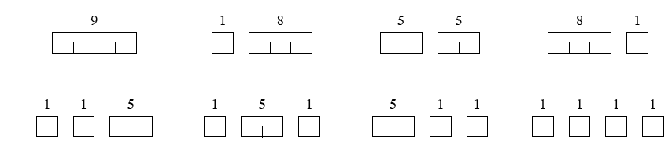
Rod Cutting
length i: 1 2 3 4 5 6 7 8
price p_{i}: 1 5 8 9 10 17 17 20
Can cut up a rod in 2^{n-1} different ways, because can choose to cut or not cut after each of the first n - 1 inches.
Here are all 8 ways to cut a rod of length 4, with the costs from the example:

Slide 23
Rod Cutting
The best way is to cut it into two 2-inch pieces, getting a revenue of p₂ + p₂ = 5 + 5 = 10.
Let r_{i} be the maximum revenue for a rod of length i. Can express a solution as a sum of individual rod lengths.

Slide 24
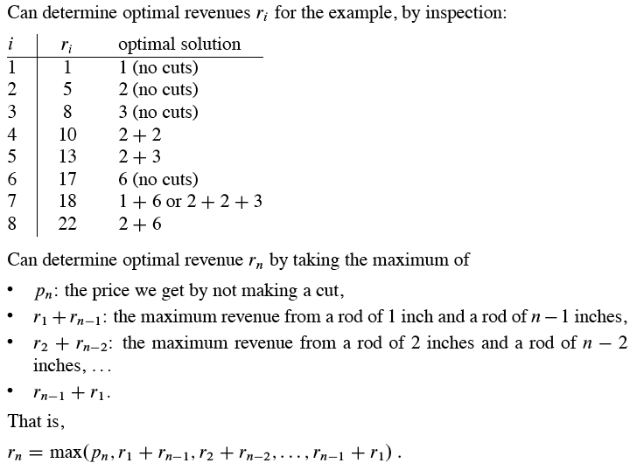

Slide 25
Optimal Substructure
To solve the original problem of size n, solve subproblems on smaller sizes. After making a cut, we have two subproblems. The optimal solution to the original problem incorporates optimal solutions to the subproblems. We may solve the subproblems independently.
Example: For n = 7, one of the optimal solutions makes a cut at 3 inches, giving two subproblems, of lengths 3 and 4. We need to solve both of them optimally. The optimal solution for the problem of length 4, cutting into 2 pieces, each of length 2, is used in the optimal solution to the original problem with length 7.

Slide 26

A simpler way to decompose the problem
Every optimal solution has a leftmost cut. In other words, there’s some cut that gives a first piece of length i cut off the left end, and a remaining piece of length n - i on the right.
Need to divide only the remainder, not the first pieces
Leaves only one subproblem to solve, rather than two subproblems.
Say that the solution with no cuts has first piece size i = n with revenue p_{n} and remainder size 0 with revenue r₀ = 0.
Gives a simpler version of the equation for r_{n} :

Slide 27
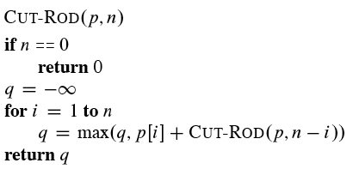
Recursive top-down solution
Direct implementation of the simpler equation for r_{n} .
The call CUT-ROD(p, n) returns the optimal revenue r_{n} :

Slide 28
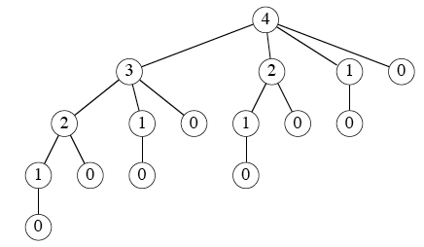
Recursive top-down solution
This procedure works, but it is terribly inefficient. If you code it up and run it, it could take more than an hour for n = 40. Running time almost doubles each time n increases by 1.
Why so inefficient?: CUT-ROD calls itself repeatedly, even on subproblems it has already solved. Here’s a tree of recursive calls for n = 4. Inside each node is the value of n for the call represented by the node:

Slide 29
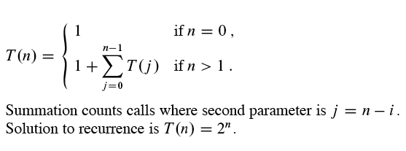
Recursive top-down solution
Lots of repeated subproblems. Solve the subproblem for size 2 twice, for size 1 four times, and for size 0 eight times.
Exponential growth: Let T(n) equal the number of calls to CUT-ROD with second parameter equal to n. Then

Slide 30
Dynamic-programming solution
Instead of solving the same subproblems repeatedly, arrange to solve each subproblem just once.
Save the solution to a subproblem in a table, and refer back to the table whenever we revisit the subproblem.
“Store, don’t recompute” ⇒ time-memory trade-off.
Can turn an exponential-time solution into a polynomial-time solution.
Two basic approaches: top-down with memoization, and bottom-up.

Slide 31
Top-down with memoization
Solve recursively, but store each result in a table.
To find the solution to a subproblem, first look in the table. If the answer is there, use it. Otherwise, compute the solution to the subproblem and then store the solution in the table for future use.
Memoizing is remembering what we have computed previously.
Memoized version of the recursive solution, storing the solution to the subproblem of length i in array entry r[i]:

Slide 32
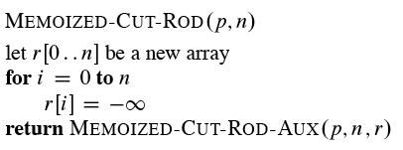
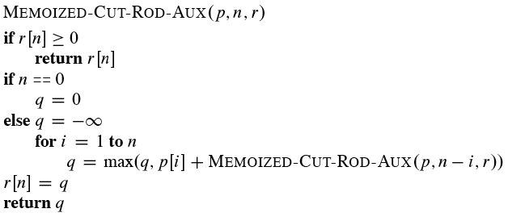
Top-down with memoization

Slide 33
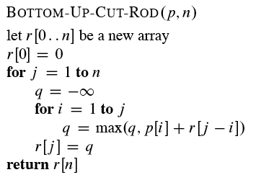
Bottom-up
Sort the subproblems by size and solve the smaller ones first. That way, when solving a subproblem, have already solved the smaller subproblems we need.

Slide 34
Running time
Both the top-down and bottom-up versions run in Θ(n²) time.
Bottom-up: Doubly nested loops. Number of iterations of inner for loop forms an arithmetic series.
Top-down: MEMOIZED-CUT-ROD solves each subproblem just once, and it solves subproblems for sizes 0, 1, . . . , n. To solve a subproblem of size n, the for loop iterates n times ⇒ over all recursive calls, total number of iterations forms an arithmetic series.

Slide 35
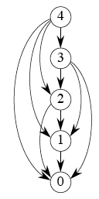
Subproblem graphs
How to understand the subproblems involved and how they depend on each other.
Directed graph:
One vertex for each distinct subproblem.
Has a directed edge (x, y) if computing an optimal solution to subproblem x directly requires knowing an optimal solution to subproblem y.
Example: For rod-cutting problem with n = 4:

Slide 36
Subproblem graphs
Can think of the subproblem graph as a collapsed version of the tree of recursive calls, where all nodes for the same subproblem are collapsed into a single vertex, and all edges go from parent to child.
Subproblem graph can help determine running time. Because we solve each subproblem just once, running time is sum of times needed to solve each subproblem.
Time to compute solution to a subproblem is typically linear in the out-degree (number of outgoing edges) of its vertex.
Number of subproblems equals number of vertices.
When these conditions hold, running time is linear in number of vertices and edges.

Slide 37
Reconstructing a solution
So far, have focused on computing the value of an optimal solution, rather than the choices that produced an optimal solution.
Extend the bottom-up approach to record not just optimal values, but optimal choices. Save the optimal choices in a separate table. Then use a separate procedure to print the optimal choices.

Slide 38
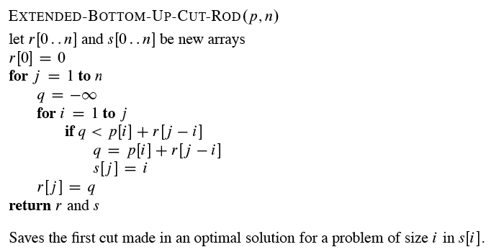
Reconstructing a solution

Slide 39
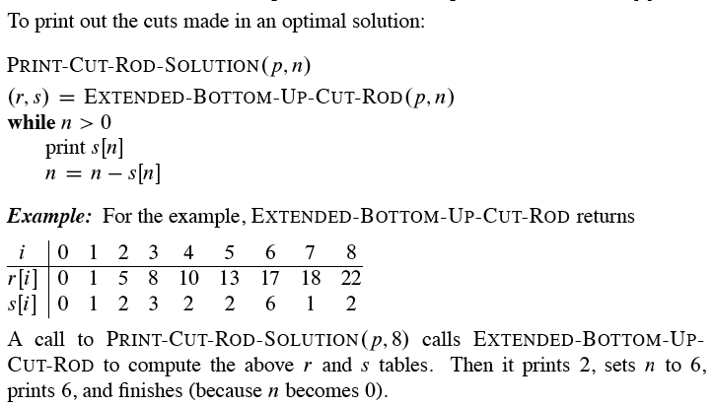
Reconstructing a solution

Slide 40
Matrix Multiplication

Slide 41
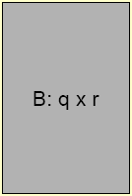

Review: Matrix Multiplication
Matrix-Multiply(A,B):
1 if columns[A] != rows[B] then
2 error "incompatible dimensions"
3 else{
5 for i = 1 to rows[A] do
6 for j = 1 to columns[B] do{
7 C[i,j] = 0
8 for k = 1 to columns[A] do
9 C[i,j] = C[i,j]+A[i,k]*B[k,j]
10 }
11 }
12 return C
Time complexity = O(pqr),
where |A|=p×q and |B|=q×r

Slide 42
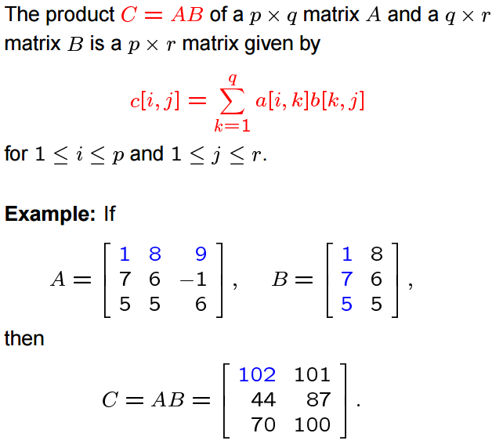
Matrix Multiplication

Slide 43
Multiplying Matrices
Two matrices, A – n×m matrix and B – m×k matrix, can be multiplied to get C with dimensions n×k, using n×m×k scalar multiplications
Problem: Compute a product of many matrices efficiently

Slide 44
Matrix Chain Multiplication [MCM]: The Problem
Input: Matrices T₁,T₂,…, T_{n}, each T_{i} of size d_{i-1} x d_{i}
Output: Fully parenthesized product T₁T₂…T_{n} that minimizes the number of scalar multiplications.
A product of matrices is fully parenthesized if it is either
a) a single matrix, or
b) the product of 2 fully parenthesized matrix products surrounded by parentheses.
Example: T₁ T₂ T₃ T₄ can be fully parenthesized as:
1. (T₁ (T₂ (T₃ T₄ ))) 4. ((T₁ (T₂ T₃ ))T₄ )
2. (T₁ ((T₂ T₃ )T₄ )) 5. (((T₁ T₂ )T₃ )T₄ )
3. ((T₁ T₂ )(T₃ T₄ ))

Slide 45
Matrix Chain Multiplication [MCM]: The Problem
Suppose size of A_{i} is p_{i-1} by p_{i}.
(A₁ ( A₂ ( A₃ A₄ ) )) : p₂ p₃ p₄ + p₁p₂p₄ + p₀p₁p₄
(((A₁ A₂) A₃) A₄ ) : p₀ p₁ p₂ + p₀p₂p₃ + p₀p₃p₄
p₁
p₂
p₃
p₄
A₁
A₂
A₃
A₄
p₀

Slide 46
Matrix Chain Multiplication [MCM]: (A₁(A₂(A₃ A₄)))
p₁
p₂
p₃
p₄
p₁
p₂
p₄
A₁
A₂
A₃
A₄
A₁
A₂
A₃ A₄
p₀
p₀
(A₃ A₄)
p₂p₃p₄ multiplications
(A₂(A₃ A₄))
p₁p₂p₄ multiplications
Total: p₂p₃p₄ + p₁p₂p₄ + p₀p₁p₄
p₄
p₁
p₄
A₁( A₂(A₃A₄))
A₁
A₂(A₃A₄)
p₀
p₀
(A₁(A₂(A₃ A₄)))
p₀p₁p₄ multiplications

Slide 47
Matrix Chain Multiplication [MCM]: (((A₁ A₂)A₃)A₄)
p₁
p₂
p₃
p₄
p₂
p₃
p₄
A₁
A₂
A₃
A₄
(A₁A₂)
A₃
A₄
p₀
p₀
(A₁ A₂)
p₀p₁p₂ multiplications
((A₁ A₂)A₃)
p₀p₂p₃ multiplications
Total: p₀p₁p₂ + p₀p₂p₃ + p₀p₃p₄
p₄
p₃
p₄
((A₁A₂)A₃)A₄
(A₁A₂)A₃
A₄
p₀
p₀
(((A₁ A₂)A₃)A₄)
p₀p₃p₄ multiplications

Slide 48
MCM: Parenthesization
Some Preliminaries
Matrix multiplication is associative
(AB)C = A(BC)
The parenthesization matters
Consider A×B×C×D, where
A is 30×1, B is 1×40,
C is 40×10, D is 10×25
Costs:
(((AB)C)D)
A=30 x 1
B=1 x 40
30x1x40
(AB)=30x40
C=40x10
30x40x10
((AB)C)=30x10
D=10x25
=1200
+
12000
+
7500
= 20700
30x10x25
(((AB)C)D)=30x25

Slide 49
MCM: Parenthesization
Some Preliminaries
Matrix multiplication is associative
(AB)C = A(BC)
The parenthesization matters
Consider A×B×C×D, where
A is 30×1, B is 1×40,
C is 40×10, D is 10×25
Costs:
(((AB)C)D)
= 1200 + 12000 + 7500 = 20700
((AB)(CD))
A=30 x 1
B=1 x 40
C=40x10
D=10x25
30x1x40
40x10x25
(AB)=30x40
(CD)=40x25
30x40x25
=1200
+
10000
+
30000
= 41200
((AB)(CD))=30x25

Slide 50
MCM: Parenthesization
Some Preliminaries
Matrix multiplication is associative
(AB)C = A(BC)
The parenthesization matters
Consider A×B×C×D, where
A is 30×1, B is 1×40,
C is 40×10, D is 10×25
Costs:
(((AB)C)D)
= 1200 + 12000 + 7500 = 20700
((AB)(CD))
= 1200 + 10000 + 30000 = 41200
(A((BC)D))
B=1 x40
C=40x10
1x40x10
(BC)=1 x10
D=10x25
1x10x25
A=30 x 1
((BC)D)=1x25
30x1x25
(A((BC)D))=30x25
=400
+
= 1400
+
250
750

Slide 51
MCM: Parenthesization
Some Preliminaries
Matrix multiplication is associative
(AB)C = A(BC)
The parenthesization matters
Consider A×B×C×D, where
A is 30×1, B is 1×40,
C is 40×10, D is 10×25
Costs:
(((AB)C)D)
= 1200 + 12000 + 7500 = 20700
((AB)(CD))
= 1200 + 10000 + 30000 = 41200
(A((BC)D))
= 400 + 250 + 750 = 1400
We need to optimally parenthesize
T₁ x T₂ x…T_{n}, where T_{i} is a d_{i-1} x d_{i} matrix.
According to the given example
d = {30, 1, 40, 10, 25 }
T₁ x T₂ x T₃ x T₄ where
T₁ = d₁₋₁ x d₁ = d₀ x d₁ = 30 x 1
T₂ = d₂₋₁ x d₂ = d₁ x d₂ = 1 x 40
T₃ = d₃₋₁ x d₃ = d₂ x d₃ = 40 x 10
T₄ = d₄₋₁ x d₄ = d₃ x d₄ = 10 x 25
Costs:
((T₁ T₂) T₃) T₄ = 20700
(T₁ T₂) (T₃ T₄) = 41200
T₁ ((T₂ T₃) T₄) = 1400

Slide 52
MCM: Parenthesization
Let the number of different parenthesizations, P(n).
Then,
Using Generating Function we have,
P(n) = C(n-1), the (n-1)^{th} Catalan Number where
Exhaustively checking all possible parenthesizations take exponential time!

Slide 53
MCM :: Step 1: Characterize Optimal Sub-structure
Let M(i, j) be the minimum number of multiplications necessary to compute T_{i..j} = T_{i} x … x T_{j}
Key observations
The outermost parenthesis partitions the chain of matrices (i, j) at some k, (i ≤ k < j): (T_{i}…T_{k})(T_{k+1}…T_{j})
The optimal parenthesization of matrices (i, j) is also optimal on either side of k; i.e., for matrices (i, k) and (k+1, j)
Within the optimal parenthesization of T_{i..j},
(a) the parenthesization of T_{i..k} must be optimal
(b) the parenthesization of T_{k+1..j} must be optimal
Why?

Slide 54
MCM :: Step 2: Recursive (Recurrence) Formulation
Need to find T_{1..n}
Let M(i, j) = minimum # of scalar multiplications needed to compute T_{i..j}
Since T_{i..j} can be obtained by breaking it into T_{i..k} & T_{k+1..j} , we have
Note: The sizes of T_{i..k} is d_{i-1} x d_{k} and T_{k+1..j} is d_{k} x d_{j} ,
and T_{i..k} T_{k+1..j} is d_{i-1} x d_{j} after d_{i-1} d_{k} d_{j} scalar multiplications.
Let s(i, j) be the value k where the optimal split occurs
A direct recursive implementation is exponential – a lot of duplicated work.
But there are only few different subproblems (i, j): one solution for each choice of i and j (i < j).

Slide 55
MCM::Step 2: Recursive (Recurrence) Formulation
Recursive-Matrix-Chain(d, i, j)
1 if i = j then
2 return 0;
3 M[i, j] = ∞;
4 for k = i to j-1 do
5 q = Recursive-Matrix-Chain(d, i, k) +
Recursive-Matrix-Chain(d, k+1, j) +
d_{i-1}d_{k}d_{j}
6 if q < M[i, j] then
M[i, j] = q ;
S[i, j] = k ;
8 return M[i, j] ;

Slide 56
MCM :: Step 2: Recursive (Recurrence) Formulation
Overlapping Subproblems
Let T(n) be the time complexity of Recursive-Matrix-Chain(d, 1, n)
For n > 1, we have
T(n)= 1 +
a) 1 is used to cover the cost of lines 1-3, and 8
b) 1 is used to cover the cost of lines 6-7
Using substitution, we can show that T(n) ≥ 2^{n-1}
Hence T(n) = Ω(2^{n})

Slide 57
MCM :: Step 3: Computing Optimal Costs
To compute T_{i..j} we need only values for subproblems of length<i-j.
Solve subproblems in the increasing length of subproblems: first subproblems of length 2, then of length 3 and so on.
Length = 4
Length = 3
Length = 2
Length = 1
T_{1..4}
An Example:
(T₂(T₃T₄))
T₂T₃T₄ =
((T₂T₃)T₄)
T_{2..2} T_{3..4}
T_{2..4} =
T_{2..3} T_{4..4}
T_{1..3}
T_{2..4}
T_{1..2}
T_{2..3}
T_{3..4}
T_{1..1}
T_{2..2}
T_{3..3}
T_{4..4}

Slide 58
MCM :: Step 3: Computing the Optimal Costs
Idea: store the optimal cost M(i, j) for each subproblem in a 2d array M[1..n,1..n]
Trivially M(i, i) = 0, 1≤ i ≤ n
To compute M(i, j), where i – j = L, we need only values of M for subproblems of length < L.
Thus we have to solve subproblems in the increasing length of subproblems: first subproblems of length 2, then of length 3 and so on.
To reconstruct an optimal parenthesization for each pair (i, j) we record in s[i, j] = k the optimal split into two subproblems (i, k) and (k+1, j)

Slide 59
MCM :: Step 3: Computing the Optimal Costs
Matrix-Chain-Order( d )
01 n = length[d]-1 //d is the array of matrix sizes
02 for i = 1 to n do
03 M[i,i] = 0 // no multiplication for 1 matrix
04 for len = 2 to n do // len is length of sub-chain
05 for i = 1 to n-len+1 do // i: start of sub-chain
06 j =i+len-1 // j: end of sub-chain
07 M[i,j] = ∞
08 for k = i to j-1 do
09 q = M[i,k]+M[k+1,j]+d_{i-1}d_{k}d_{j}
10 if q < M[i,j] then
11 M[i,j] = q
12 s[i,j] = k
13 return M and s
Time complexity = O(n3 )

Slide 60
MCM :: Step 3: Computing the Optimal Costs
After the execution: M [1,n] contains the value of an optimal solution and s contains optimal subdivisions (choices of k) of any subproblem into two sub-subproblems
Let us run the algorithm on the six matrices:
d={ 30, 35, 15, 5, 10, 20, 25 }
See CLRS Figure 15.3
Matrix | Dimension
T1 | 30 X 35
T2 | 35 X 15
T3 | 15 X 5
T4 | 5 X 10
T5 | 10 X 20
T6 | 20 X 25

Slide 61
Simulation-MCM
 | 0 | 1 | 2 | 3 | 4 | 5 | 6
d | 30 | 35 | 15 | 5 | 10 | 20 | 25
Matrix-Chain-Order( d )
01 n = length[d]-1
02 for i = 1 to n do
03 M[i,i] = 0
04 for len = 2 to n do
05 for i = 1 to n-len+1 do
06 j =i+len-1
07 M[i,j] = ∞
08 for k = i to j-1 do
09 q = M[i,k]+M[k+1,j]+d_{i-1}d_{k}d_{j}
10 if q < M[i,j] then
11 M[i,j] = q
12 s[i,j] = k
13 return M and s
M | 1 | 2 | 3 | 4 | 5 | 6
1
2
3
4
5
6
S | 1 | 2 | 3 | 4 | 5 | 6
1
2
3
4
5
6

Slide 62
Simulation-MCM
 | 0 | 1 | 2 | 3 | 4 | 5 | 6
d | 30 | 35 | 15 | 5 | 10 | 20 | 25
Matrix-Chain-Order( d )
01 n = length[d]-1
02 for i = 1 to n do
03 M[i,i] = 0
04 for len = 2 to n do
05 for i = 1 to n-len+1 do
06 j =i+len-1
07 M[i,j] = ∞
08 for k = i to j-1 do
09 q = M[i,k]+M[k+1,j]+d_{i-1}d_{k}d_{j}
10 if q < M[i,j] then
11 M[i,j] = q
12 s[i,j] = k
13 return M and s
M | 1 | 2 | 3 | 4 | 5 | 6
1 | 0
2 |  | 0
3 |  |  | 0
4 |  |  |  | 0
5 |  |  |  |  | 0
6 |  |  |  |  |  | 0
S | 1 | 2 | 3 | 4 | 5 | 6
1
2
3
4
5
6

Slide 63
Simulation-MCM
 | 0 | 1 | 2 | 3 | 4 | 5 | 6
d | 30 | 35 | 15 | 5 | 10 | 20 | 25
Matrix-Chain-Order( d )
01 n = length[d]-1
02 for i = 1 to n do
03 M[i,i] = 0
04 for len = 2 to n do
05 for i = 1 to n-len+1 do
06 j =i+len-1
07 M[i,j] = ∞
08 for k = i to j-1 do
09 q = M[i,k]+M[k+1,j]+d_{i-1}d_{k}d_{j}
10 if q < M[i,j] then
11 M[i,j] = q
12 s[i,j] = k
13 return M and s
M | 1 | 2 | 3 | 4 | 5 | 6
1 | 0 | 15750
2 |  | 0 | 2625
3 |  |  | 0 | 750
4 |  |  |  | 0 | 1000
5 |  |  |  |  | 0 | 5000
6 |  |  |  |  |  | 0
S | 1 | 2 | 3 | 4 | 5 | 6
1 |  | 1
2 |  |  | 2
3 |  |  |  | 3
4 |  |  |  |  | 4
5 |  |  |  |  |  | 5
6
len=2, [i,j]=[1,2] to [5,6], k = 1 to 5
M[1,2] = M[1,1]+M[2,2]+d₀*d₁*d₂ = 0+0+30*35*15 = 15750;
M[2,3] = M[2,2]+M[3,3]+d₁*d₂*d₃ = 0+0+35*15* 5 = 2625;
M[3,4] = M[3,3]+M[4,4]+d₂*d₃*d₄ = 0+0+15* 5*10 = 750;
M[4,5] = M[4,4]+M[5,5]+d₃*d₄*d₅ = 0+0+ 5*10*20 = 1000;
M[5,6] = M[5,5]+M[6,6]+d₄*d₅*d₆ = 0+0+10*20*25 = 5000;
Sajib Hasan
AIUB::CSC2105::Algorithms
Dynamic Programming→63

Slide 64
Simulation-MCM
 | 0 | 1 | 2 | 3 | 4 | 5 | 6
d | 30 | 35 | 15 | 5 | 10 | 20 | 25
Matrix-Chain-Order( d )
01 n = length[d]-1
02 for i = 1 to n do
03 M[i,i] = 0
04 for len = 2 to n do
05 for i = 1 to n-len+1 do
06 j =i+len-1
07 M[i,j] = ∞
08 for k = i to j-1 do
09 q = M[i,k]+M[k+1,j]+d_{i-1}d_{k}d_{j}
10 if q < M[i,j] then
11 M[i,j] = q
12 s[i,j] = k
13 return M and s
M | 1 | 2 | 3 | 4 | 5 | 6
1 | 0 | 15750
2 |  | 0 | 2625
3 |  |  | 0 | 750
4 |  |  |  | 0 | 1000
5 |  |  |  |  | 0 | 5000
6 |  |  |  |  |  | 0
S | 1 | 2 | 3 | 4 | 5 | 6
1 |  | 1
2 |  |  | 2
3 |  |  |  | 3
4 |  |  |  |  | 4
5 |  |  |  |  |  | 5
6
Len=
[i, j]=[ |  | , |  | ] to [ |  | , |  | ]
k=
M[ |  | , |  | ]= | M[ |  | , |  | ]+ | M[ |  | , |  | ]+ | d |  | * | d |  | * | d
 |  |  |  | = |  |  |  |  | + |  |  |  |  | + |  |  | * |  |  | * |  |  | =
Sajib Hasan
AIUB::CSC2105::Algorithms
Dynamic Programming→64

Slide 65
MCM :: Step 4: Constructing Optimal Solution
To get the optimal solution T_{1..6}, s[] is used as follows:
T_{1..6}
= (T_{1..3} T_{4..6}) ;since s[1,6] = 3
= ((T_{1..1} T_{2..3} )(T_{4..5} T_{6..6} )) ;since s[1,3] =1 and s[4,6]=5
=((T₁ (T₂ T₃ ))((T₄ T₅ )T₆ ))
MCM can be solved in O(n3) time

Slide 66
Matrix Chain Multiplication Problem
Running time
It is easy to see that it is O(n³) (three nested loops)
It turns out it is also Ω(n³)
Thus, a reduction from exponential time to polynomial time.

Slide 67
Memoization
Memoization is one way to deal with overlapping subproblems
After computing the solution to a subproblem, store it in a table
Subsequent calls just do a table lookup
Can modify recursive algorithm to use memoziation
If we prefer recursion we can structure our algorithm as a recursive algorithm:
Initialize all elements to ∞ and call MemoMCM(i,j)
MemoMCM(i,j)
if i = j then return 0
else if M[i,j] < ∞ then return M[i,j]
else for k := i to j-1 do
q := MemoMCM(i,k)+ MemoMCM(k+1,j) + d_{i-1}d_{k}d_{j}
if q < M[i,j] then
M[i,j] := q
return M[i,j]

Slide 68
Memoization
Memoization:
Solve the problem in a top-down fashion, but record the solutions to subproblems in a table.
Pros and cons:
L Recursion is usually slower than loops and uses stack space
J Easier to understand
J If not all subproblems need to be solved, you are sure that only the necessary ones are solved

Slide 69
Longest Common Subsequence

Slide 70
Longest Common Subsequence The Problem
Given two sequences
X = < x₁, x₂, … , x_{m} >
Z = < z₁, z₂, … , z_{k} >
Z is a subsequence of X if
z_{j} = x_{i( j )} for all j = 1, … , k
where <i(1),i(2),…,i(k)> is strictly increasing (but not required to be consecutive)
Examples:
Let X = < A, B, C, B, D, A, B >
< A >, < B >, < C >, and < D > are subsequences.
< C, A >, < C, B >, < C, B, A, B > are subsequences.
How many possible subsequences for a n-element sequence?

Slide 71
Longest Common Subsequence Problem
Z is a common subsequence of sequences X and Y if Z is a subsequence of both X and Y.
Example:
Let X = < A, B, C, B, D, A, B > and Y = < B, D, C, A, B, A >
< A >, <B>, <C>, and <D> are common subsequences.
< C, A > is, but < A, C > is not.
< B, C, A> is a common subsequence
< B, C, B, A > is the longest common subsequence.
Example:
x = “sariempiolcewe”
y = “westigmupsalrte”

Slide 72
Longest Common Subsequence Problem
LCS:
Input: two sequences x[1..m] and y[1..n]
Output: longest common subsequence of x and y (denoted LCS(x,y))
Brute-force algorithm:
For every subsequence of x, check if it is a subsequence of y
2^{m} subsequences of x to check against n elements of y : O(n 2^{m})

Slide 73
LCS: Optimal Sub-structure
The i^{th} prefix of X = < x₁,x₂,…,x_{m} > is denoted X_{i} = < x₁,x₂,…,x_{i} >
X₀ is the empty sequence
X_{m} is the whole sequence X
Theorem 15.1 (Optimal Sub-structure of LCS)
Let X=<x₁,x₂,…,x_{m}>, Y=<y₁,y₂,…,y_{n}>, and Z=<z₁,z₂,…,z_{k}> be LCS(X,Y).
(1) If x_{m}= y_{n}, then z_{k} = x_{m} = y_{n} and Z_{k-1} is LCS(X_{m-1},Y_{n-1})
(2) if x_{m} ≠ y_{n}, then z_{k} ≠ x_{m} implies Z is LCS(X_{m-1},Y)
(3) if x_{m} ≠ y_{n}, then z_{k} ≠ y_{n} implies Z is LCS(X,Y_{n-1})

Slide 74
LCS: Optimal Substructure
We make Z to be empty and proceed from the ends of X_{m}=“x₁ x₂ …x_{m}” and Y_{n}=“y₁ y₂ …y_{n}”
If x_{m}=y_{n}, append this symbol to the beginning of Z, and find optimally LCS(X_{m-1}, Y_{n-1})
If x_{m}≠y_{n},
Skip either a letter from X
or a letter from Y
Decide which decision to do by comparing
LCS(X_{m}, Y_{n-1}) and LCS(X_{m-1}, Y_{n})
Starting from beginning is equivalent.

Slide 75
LCS: Optimal Substructure
LCS has an optimal sub-structure defined by prefixes of X and Y
The sub-problems of finding LCS(X_{m-1},Y_{n}) and LCS(X_{m},Y_{n-1}) share a common sub-sub-problem of finding LCS(X_{m-1},Y_{n-1}). They are overlapping.
Simplify: just worry about LCS length for now
Define c[i, j] = length of LCS(X_{i}, Y_{j})
So c[m, n] = length of LCS(X, Y)

Slide 76
LCS: Recurrence
Define c[i, j] = length of LCS of x[1..i], y[1..j]
Note that the conditions in the problem restrict sub-problems (if x_{i} = y_{i} we consider x_{i-1} and y_{i-1}, etc)
Use b[i, j] to remember where to extract an element of an LCS.

Slide 77
LCS: Recurrence
int lcsRec(int i, int j) {
if (i==0 || j==0) return 0;
else if (x[i] == y[j])
return lcsRec(i-1,j-1) + 1;
else
return max(lcsRec(i-1,j),lcsRec(i,j-1));
}
Recurrence for time complexity:
T(2n)=T(2n-2)+1 if x[n]=y[n]
T(2n)=2T(2n-1) if x[n]!=y[n]
T(2n)=1 if n=0
T(2n)=2T(2n-1)
=2(2T(2n-2))
=4T(2n-2)
=4(2T(2n-3))
=8T(2n-3)
=2^{i}T(2n-i)
= 2^{2n} = 4^{n}

Slide 78
LCS: Recurrence
int lcsMemo(int i, int j) {
if (c[i][j] != -1) return c[i][j]
else if (x[i] == y[j]) {
c[i][j] = lcsMemo(i-1,j-1) + 1
return c[i][j]
}
else {
c[i][j]=max(lcsMemo(i-1,j),lcsMemo(i,j-1))
return c[i][j]
}
}
c String x
T(n) = O(n²)
String y

Slide 79
LCS: Computing Length
LCS-Length(X, Y, m, n)
1 for i←1 to m do
2 c[i,0] ← 0
3 for j←0 to n do
4 c[0,j] ← 0
5 for i←1 to m do
6 for j←1 to n do
7 if x_{i} = y_{j} then
c[i,j] ← c[i-1,j-1]+1
9 b[i,j] ← ”copy”
10 else if c[i-1,j] ≥ c[i,j-1] then
c[i,j] ← c[i-1,j]
b[i,j] ← ”skipX”
13 else
c[i,j] ← c[i,j-1]
b[i,j] ← ”skipY”
16 return c, b

Slide 80
LCS: Example
0, if i=0, j=0
c[i,j] = c[i-1,j-1]+1 if i,j>0 and x_{i} = y_{j}
max ( c[i,j-1], c[i-1,j] ) if i,j>0 and x_{i} ≠ y_{i}
X
a
b
b
c
a
a
c
Y
0
0
0
0
0
0
0
0
a
0
c
0
c
0
b
0
c
0
c
0
a
0

Slide 81
LCS: Example
0, if i=0, j=0
c[i,j] = c[i-1,j-1]+1 if i,j>0 and x_{i} = y_{j}
max ( c[i,j-1], c[i-1,j] ) if i,j>0 and x_{i} ≠ y_{i}
a
b
b
c
a
a
c
0
0
0
0
0
0
0
0
a
0
c
0
c
0
b
0
c
0
c
0
a
0

Slide 82
LCS: Example
0, if i=0, j=0
c[i,j] = c[i-1,j-1]+1 if i,j>0 and x_{i} = y_{j}
max ( c[i,j-1], c[i-1,j] ) if i,j>0 and x_{i} ≠ y_{i}
a
b
b
c
a
a
c
0
0
0
0
0
0
0
0
a
0
c
0
c
0
b
0
c
0
c
0
a
0

Slide 83
LCS: Example
0, if i=0, j=0
c[i,j] = c[i-1,j-1]+1 if i,j>0 and x_{i} = y_{j}
max(c[i,j-1],c[i-1,j]) if i,j>0 and x_{i} ≠ y_{i}
a
b
b
c
a
a
c
0
0
0
0
0
0
0
0
a
0
1
1
1
1
1
1
1
c
0
1
1
1
2
2
2
2
c
0
1
1
1
2
2
2
3
b
0
1
2
2
2
2
2
3
c
0
1
2
2
3
3
3
3
c
0
1
2
2
3
3
3
4
a
0
1
2
2
3
4
4
4

Slide 84
Constructing an LCS
Print-LCS(b, X, i, j)
1 if i = 0 or j = 0 then
2 return
3 if b[i,j] = “copy" then
4 Print-LCS(b,X,i-1,j-1)
5 print x[i]
6 elseif b[i,j]=“skipX" then
7 Print-LCS(b,X,i-1,j)
8 else
Print-LCS(b,X,i,j-1)
length[X] = m, length[Y] = n,
Call Print-LCS(b, X, n, m) to construct LCS
Time complexity: O(m+n).

Slide 85
LCS: Example
0, if i=0, j=0
c[i,j] = c[i-1,j-1]+1 if i,j>0 and x_{i} = y_{j}
max(c[i,j-1],c[i-1,j]) if i,j>0 and x_{i} ≠ y_{i}
a
b
b
c
a
a
c
0
0
0
0
0
0
0
0
a
0
1
1
1
1
1
1
1
c
0
1
1
1
2
2
2
2
c
0
1
1
1
2
2
2
3
b
0
1
2
2
2
2
2
3
c
0
1
2
2
3
3
3
3
c
0
1
2
2
3
3
3
4
a
0
1
2
2
3
4
4
4

Slide 86
Longest Common Subsequence
There is a need to quantify how similar they are:
Comparing DNA sequences in studies of evolution of different species
Spell checkers
Editing

Slide 87
References & Readings
CLRS:
15.2, 15.3, 15.4
Exercises: 15.2-1, 15.2-2, 15.2-3, 15.3-2, 15.4-1, 15.4-3, 15.4-5, 15.4-6.
Problems: 15-3.
HSR:
5.6

